Slide 1
CS 4530: Fundamentals of Software Engineering
Module 12.2: Threat Modeling
Adeel Bhutta, Joydeep Mitra and Mitch Wand
Khoury College of Computer Sciences
© 2025, released under CC BY-SA

Slide 2
Learning Objectives for this Module
By the end of this module, you should be able to:
Appreciate the need for threat modelling
Understand the process of threat modeling
Understand the STRIDE framework
Integrate threat modelling with requirements

Slide 3
Outline of this lecture
The need for Threat Modelling
The Threat Modelling Method
The STRIDE Framework
How to Apply Threat Modelling in an Agile Process Model
Notes:
<Read slide>
Part 2 is the largest portion of the lecture.

Slide 4
Secure By Design
Traditional Software Process Models do not bake security into the software development lifecycle.
Security issues are usually an after thought.
The modern approach to secure software engineering is to consider security during the design phase.
A useful method to do secure by design is through threat modeling.

Slide 5
What is Threat Modeling?
Identification: Recognizing potential threats to your system.
Assessment: Evaluating the likelihood and impact of each threat.
Countermeasures: Implementing strategies to mitigate or prevent identified threats.
Review: Regularly reviewing and updating threat models to adapt to evolving risks.

Slide 6
Getting Started with Threat Model
Getting Started with Threat Modelling
Concentrate on technical risks rather than broad threats.
Are there any missing controls?
Is there a data flow that can be abused?
Technical threats combine to create broad threats.
Focusing on vague nation-state attacks and zero-day exploits can overshadow essential application security details.

Slide 7
Getting Started with Threat Modeling
Getting Started with Threat Modelling
Getting Started with Threat Modeling
Collaborate with stakeholders
Diverse views on security are necessary to define a comprehensive model.
Product owners or clients must be involved to gain perspective on user behavior and prioritizing risks.

Slide 8
Getting Started with Threat Modeling
Getting Started with Threat Modelling
Getting Started with Threat Modeling
Frequent and small iterations
Start with the thinnest slice of the system. E.g.,
User registration flow.
A microservice and it’s collaborating services.
Current iteration
Repeat and refine them.
Defining a threat model upfront for the entire system is counter productive.

Slide 9
Basic Structure of Threat Modeling in Agile
An effective threat modeling session must deal with the three primary questions
Activity | Question | Outcome
Explain and explore | What are you building? | A technical diagram
Brainstorm threats | What can go wrong? | A list of technical threats
Prioritize and fix | What are you going to do? | Add prioritized fixes to backlog (todo list)

Slide 10
An Example
“As a customer, I need a page where I can see my customer details so I can confirm they are correct”
An Epic (high-level requirement) in Agile
- Epics are specified as user stories
- and broken down into sprints.

Slide 11
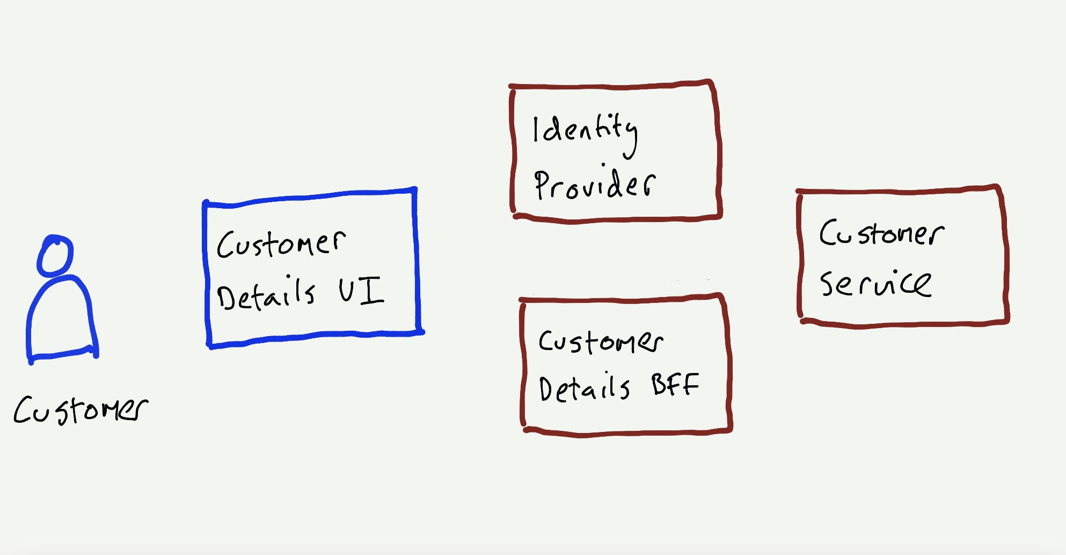
An Example
What are we building?
Use a sketch to represent
relevant components
users that interact with a component
collaborative components

Slide 12
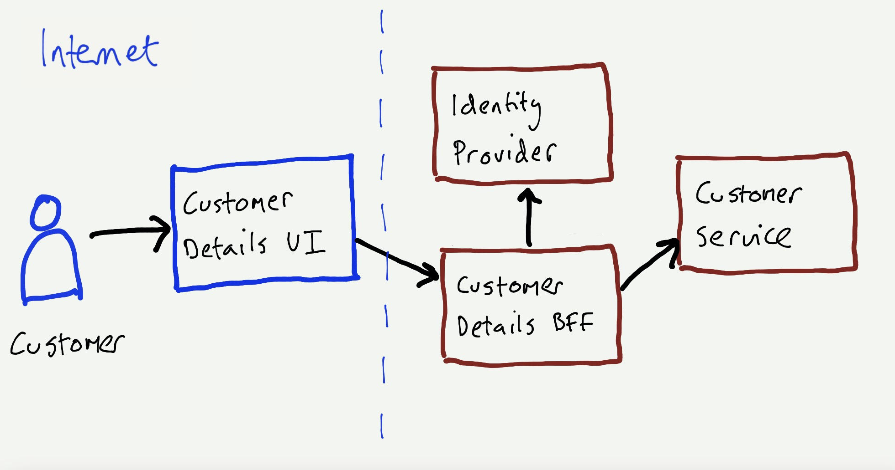
An Example
What are we building?
Explicitly model data flows in the sketch.
Data flows help show where requests originate (source).
Label networks and show boundaries between them.
Collaborate with DevOps if you need to include firewalls and load balancers in the analysis.

Slide 13
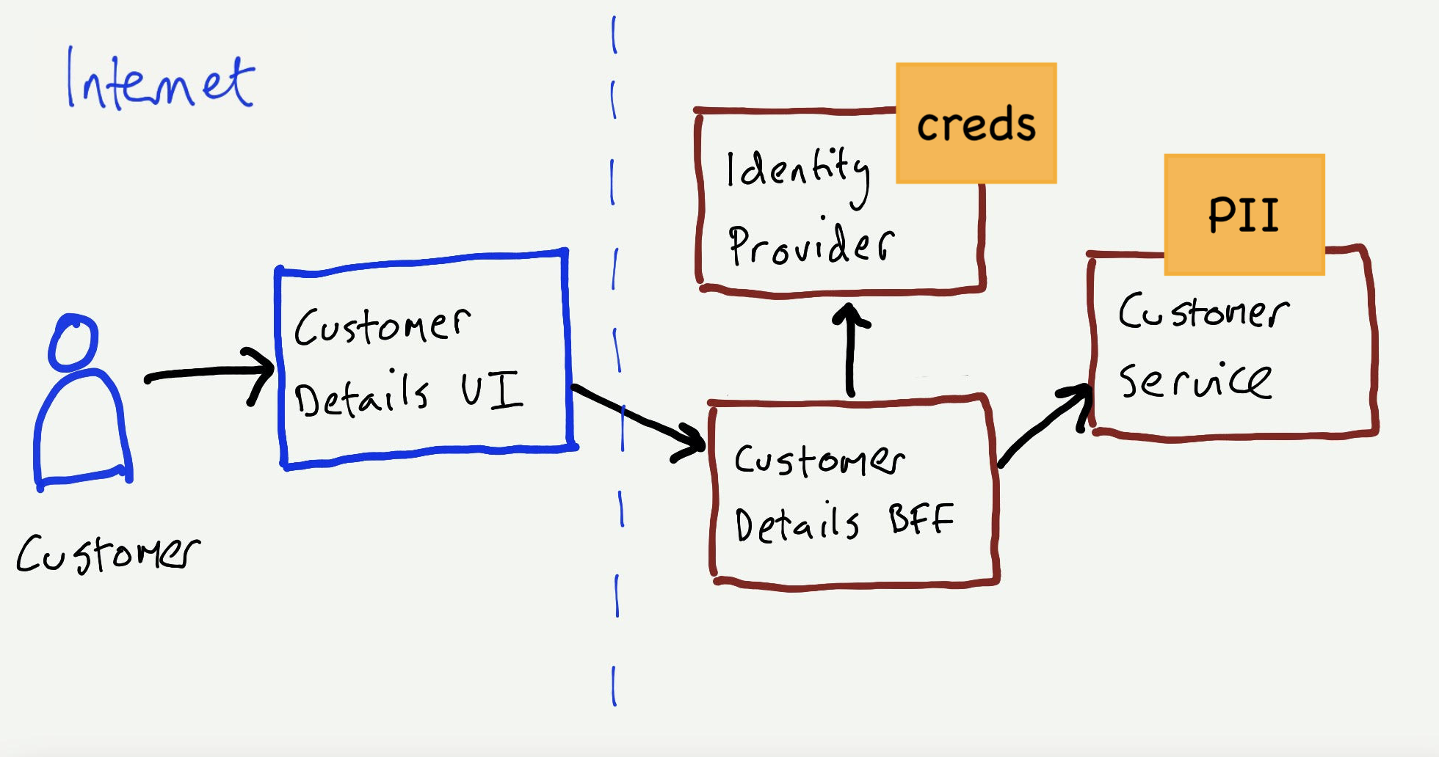
An Example
What are we building?
Identify and show assets e.g., personally identifiable information (PII), your application has access to.
Often derived from business requirements and the operating environment.

Slide 14
Brainstorming Threats
The STRIDE framework is useful to reason about potential threats.
Spoofing.
Tampering.
Repudiation.
Information Disclosure.
Denial of Service.
Elevation of Privilege.
Notes:
At this point refer to the activity on STRIDE and walk through the examples

Slide 15
Security Properties
A threat is a potential danger or risk that could compromise the CIA properties of an application.
Confidentiality: Ensuring that sensitive information is accessible only to authorized individuals or entities.
Integrity: Guaranteeing that data remains unchanged and uncorrupted during storage, transmission, or processing.
Availability: Ensuring that information and resources are accessible and usable when needed by authorized users.
Addressing the STRIDE threats helps meet the CIA properties of a system

Slide 16
Back to The Example
Using the STRIDE model, we should identify possible threats that can happen on each flow.
Customer -> UI
Customer -> Identity Service
UI -> BFF
BFF -> Customer Service

Slide 17
Back to The Example
Using the STRIDE model, we should identify possible threats that can happen on each flow.
Customer -> UI
Customer -> Identity Service
UI -> BFF
BFF -> Customer Service
No 2-factor authentication
XSS attack
Absent/weak authentication (server-to-server)
No logging of caller identity
Privilege escalation by authenticated user
Absent/weak identity token validation
injection attacks
Misconfigured TLS configuration
Privilege of escalation by authenticated user
Flood of traffic from bots

Slide 18

Prioritize and Fix
Threats need to be prioritized as teams don’t have unlimited bandwidth and some threats may not be significant.
Prioritization criteria:
Will the threats jeopardize organization objectives?
Opinion of product owners and security teams.
What does everyone on the team think? Vote!
Aim to address at least three threats. Could be more but three is a manageable number.

Slide 19
Address Threats
Prioritize and Fix
Threats of the highest priority must be added to the requirements (or backlog for agile).
Few ways to concretely document.
Conditions of Satisfaction: Extend an extended scenario with additional (security) constraints in a way that is testable.
Story: The identified threat might need a story of its own.
Definition of Done (DoD): If all features need to be extended then specify it as a DoD applicable to all features.
Epics: A significant architecture specification to address a threat. E.g., adding an identity provider or configuring a network gateway.

Slide 20
Example Specification
Suppose the team identified the following threats to be addressed:
Authorization bypass when accessing an API.
XSS attack via user input.
Denial of service from the internet.

Slide 21
All API changes tested for sanitization of XSS and SQL injection attacks.
Given the user is logged in
When they request to view their profile page
And they have a valid token
Then their profile page is displayed
Given the user is logged in
When they request to view their profile page
But they do not have a valid token
Then they are asked to login or signup
This applies to all features. Hence, expressed as Definition of Done.
all Internet facing UI and API requests to pass through the Content Delivery Network to prevent DDoS attacks.
Extend the existing view user profile page scenario with conditions of satisfaction for authorization bypass.
An epic that requires architectural changes in collaboration with a security expert and the DevOps team.

Slide 22
Additional Reading
A Guide to Threat Modeling by Jim Gumbley.
https://martinfowler.com/articles/agile-threat-modelling.html

